Slide 1
NAWI RO Analysis Progress Report
SGDC
W. Kumagai, H. Soya, R. Imoto
Operational Excellence Gr., Project Design Dev.,
Innovation Center, MKHQ, YHQ
June 22th, 2023

Slide 2
Agenda
井本さんパートで、最初にLVMWDの受領データやRO構成を説明するスライドを作ってください
RO Permeate Water Quality Prediction
RO Membrane Fouling Modeling
RO Optimization Concept
Q&A / Discussion
Notes:
This is today’s agenda. There are three parts, first part is RO Permeate Water Quality Prediction, second part is RO Membrane Fouling Modeling, third part is RO Optimization Concept. We’ll have a Q&A in final part. If you have any questions, please save them until the end.

Slide 3
Objective of RO Optimization
3. RO Optimization Concept
Operating costs are minimized considering RO membrane condition within the range of maintaining water quality and flow rate.
Maintaining high recovery rate, good water quality (high salt rejection), and extending RO membrane life.
Disinfection/ NaClO
Oxidation/
UV radiation with Chemical
Clogging Prevention/ Anti-Scalant
UF
RO
UV／AOP
Potable Water
Chemical Costs
Chemical Costs
Membrane Cleaning Costs
Electricity Costs
Water quality and flow rate to be maintained
Clogging due to fouling Scaling by crystallization Bio-fouling by deposit
Membrane Replacement Costs
Chemical Costs
Control Carcinogens
Notes:
First, I explain RO data analysis and optimization policy. This slide shows potable water reuse process. Water from sewage plant is treated by this process and supplied to potable reuse. Las Virgenes
It mainly consists of UF, RO, UV, and AOP process units. The objective of RO optimization shows operating costs are ~. There are important costs in many units, for example, chemical cost, RO membrane cleaning cost, and electricity cost. Moreover, there are considering conditions in many units, for example, recovery rate, water quality, and RO membrane life. So, optimization strategy is to select critical costs and conditions according to priority.

Slide 4
Subdivided Objective
3. RO Optimization Concept
The objective can be subdivided into the following three steps.
Optimization of membrane condition fixed
（1）Considering permeate water quality and feed flow
Reduce excessive chemical dosage to meet water demand
（2）Considering clogging status of RO membrane (monitoring the clogging)
Monitoring membrane condition taking advantage of optimization
Cleaning when the clogging status reaches the criteria limit rather than periodically (reduces excessive chemical cleaning)
（3）Considering deterioration of RO membrane (the life extension)
Continue operation until replacement criteria based on expecting life
(Prevent unnecessary replacement)
(How continue operation and extent to the life if deterioration is severe, etc.)
Notes:
The objective can be subdivided into the following three steps. First step is considering~, to reduce excessive~. Second step is considering ~ that is monitoring the clogging, to clean when the clogging status~. Third step is considering ~ that is the life extension, to~. First stage can be rephrased as optimization of membrane condition fixed. On the contrary, Second and third steps can be rephrased as monitoring membrane condition taking advantage of optimization.

Slide 5
Focused Region
1. RO Analytical Policy
Expand the control and considered value step by step.
Fix to the actual value when optimization calculation if the value is not considered
Subject to be optimization target if interchangeable with RO.
Membrane Cleaning
UV Radiation with H₂O₂ or NaClO
NaClO
Acid
Anti-Scalant
UF
RO
UV / AOP
Potable Water
Given Region
Degree of Clogging
Given Region
Water Quality
Membrane Life
(1) Considering permeate water quality and feed flow
Non-Monitoring membrane status
(2) Considering clogging status of RO membrane (monitoring the clogging)
Monitoring membrane status
(3) Considering deterioration of RO membrane (the life extension)
Notes:
Based on the steps, RO analytical policy is to expand the control and considered value step by step. First step is to control and consider yellow values. Green values are added in second step and red values are added in third step as well. But gray regions are considered as given area in RO optimization, so they are fixed to actual value when calculation.

Slide 6
Objective (1): Operation considering permeate water quality and feed flow
1. RO Analytical Policy
Optimization: Reduce chemical costs within the balance of water quality and flow rate in Pre & Post-RO.
Modeling: Predict Post-RO water quality and flow rate based on Pre-RO data.
Membrane Cleaning
UV Radiation with
H₂O₂ or NaClO
NaClO
Acid
Anti-Scalant
UF
Potable Water
RO
UV / AOP
Water Quality
Given Region
Degree of Clogging
Membrane life
Given Region
Pre-RO
Water Quality and Flow Rate
Predict water quality
Post-RO
Water Quality
Flow rate should be constant.
Prediction Model
Time
Optimization Model
Time
Decide operation values
Notes:
We are trying the first step now. This is an overview in first step. Optimization is to reduce chemical costs ~ Post-RO. And modeling is to predict ~. Please have a look at the lower figure. Left is water quality and flow rate in pre-RO. We plan to predict water quality in post-RO from left data. After that, we plan to decide the best operation values from right data by optimization. So, we need to build the quality prediction model and optimization model. This is the end of RO analytical policy. I’ll switch to Imoto-san.

Slide 7
Agenda
RO Analytic Policy
LVMWD RO Data Analysis
Data Description
Focus Points
Result
Future Tasks
Q&A / Discussion
Notes:
Next, I would like to talk about the LasVirgenes (Municipal Water District) RO Data Analysis.
This part consists of 4 topics,
①Data Description ②Focus Points ③Result ④Future Tasks.

Slide 8
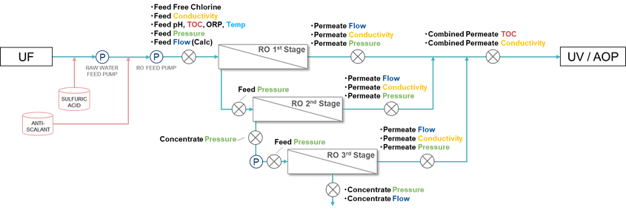
Overall view of RO system
2. LVMWD Data RO Analysis ①Data Description
3 Stages configuration and Toray’s TM720-370 is deployed
Data Period
Three years of data since 2020 are available.
Provided minute interval data were converted to daily trends.
UF
RO
UV／AOP
Potable Water
measuring point
P
pump
Notes:
Now, Let’s start with Data Description. First is overall view of the RO membrane system of Las Virgenes.
The RO system of Las Virgenes consists of three stages, 1st, 2nd, 3rd stage from the upstream.
RO membranes are Toray’s TM720-370.
〇×marks are the measuring point. They collect the data like pressure, conductivity, TOC and so on.
〇P indicates the place of pump.
About three years data from 2020 are available. We converted minute data to daily trend.
Through the daily trend, we wanted to see the long-term trend of each variable.

Slide 9
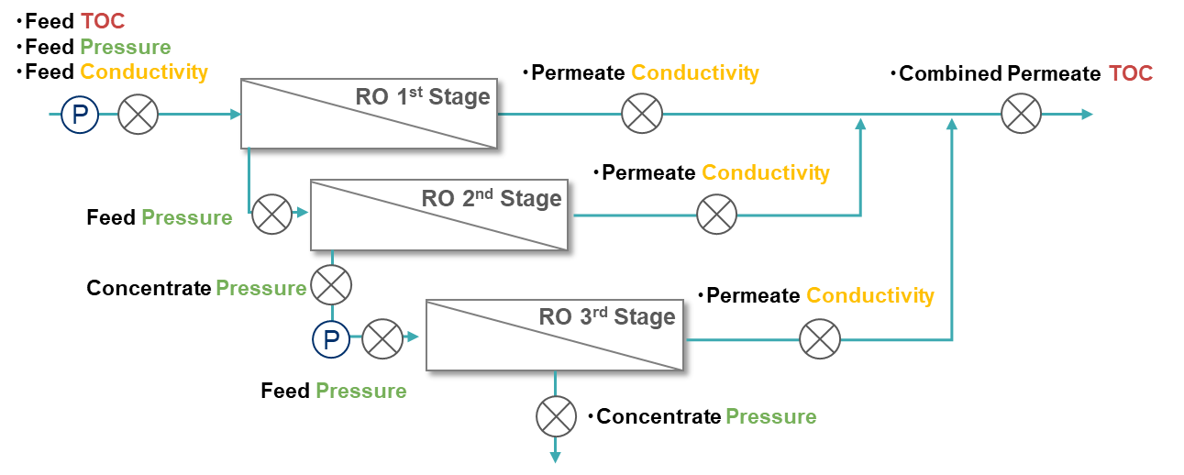
Calculation Tag
2. LVMWD Data RO Analysis ①Data Description ②Focus Points
Focus Points
Differential Pressure between modules
1st Stage DP = 1st Stage Feed Pressure – 2nd Stage Feed Pressure
2nd Stage DP = 2nd Stage Feed Pressure – 2nd Stage Concentrate Pressure
3rd Stage DP = 3rd Stage Feed Pressure – 3rd Stage Concentrate Pressure
TOC Removal Ratio
Conductivity
Notes:
Next is Focus Points on the analysis.
We select 3 key data, ① Differential Pressure between modules ②TOC Removal Ratio ③Conductivity.
Firstly, we calculate 1st Stage DP, 2nd Stage DP and 3rd DP.
1st Stage DP equals 1st Stage Feed Pressure – 2nd Stage Feed Pressure.
2nd Stage DP equals 2nd Stage Feed Pressure – 2nd Stage Concentrate Pressure.
3rd Stage DP equals 3rd Stage Feed Pressure – 3rd Stage Concentrate Pressure.
Secondly, we calculate TOC Removal Ratio.
TOC Removal Ratio is Feed TOC at RO 1st stage – combined permeate TOC divided by Feed TOC at RO 1st stage (multiplied by) 100.
It is an indicator for checking water quality on site.
Thirdly, we focus on conductivity.

Slide 10
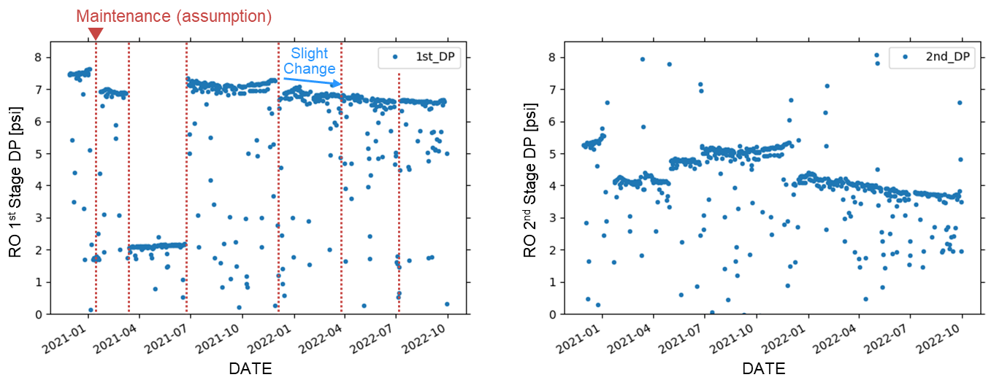
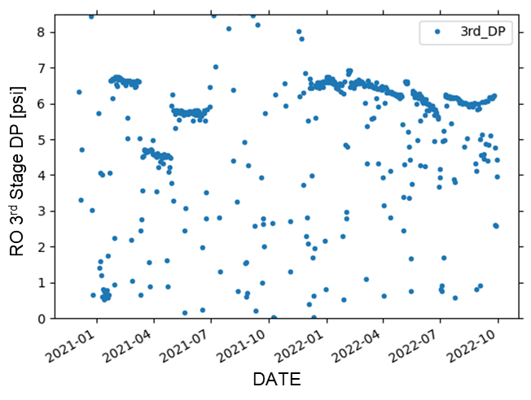
Differential Pressure between modules
2. LVMWD Data RO Analysis ③Result
DP trends change before and after the maintenance event like CIP. However, information is not clear to identify the event.
While the CIP interval, DP decay is limited in 0.1 psi/month, 1.5%/month based on 2022.
RO 1st Stage DP [psi]
RO 2nd Stage DP [psi]
RO 3rd Stage DP [psi]
Notes:
Next is analysis Result.
First is about Differential Pressure between modules.
There is the trend of DP, from left to right: 1st Stage DP, 2nd Stage DP, 3rd Stage DP.
Vertical axis is DP. Horizontal axis is date.
The red dotted line is assumed to be the timing of maintenance.
These trends show that DP trends change before and after the maintenance event like CIP.
However, information is not clear to identify the event.
While the CIP interval, DP decay is limited in 0.1 psi/month, 1.5%/month based on 2022.

Slide 11
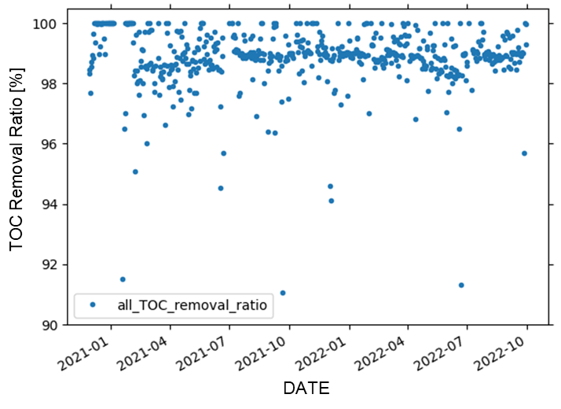
TOC Removal Ratio
2. LVMWD Data RO Analysis ③Result
TOC Removal were approximately 98.89 ± 0.95%.
The data below 99% were also scattered, and the reason and necessity of verification are not clear.
TOC Removal Ratio [%]
Notes:
Second is about TOC Removal Ratio.
This is the trend of TOC Removal Ratio.
Vertical axis is TOC Removal Ratio. Horizontal axis is date.
TOC Removal Ratio were approximately 98.89 ± 0.95%.
The data below 99% were also scattered, and the reason and necessity of verification are not clear. We need to clarify.

Slide 12
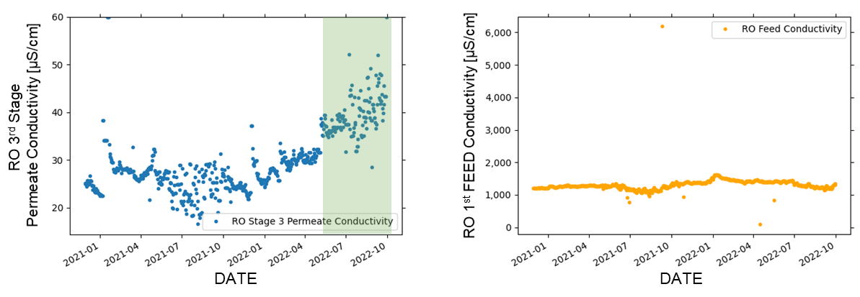
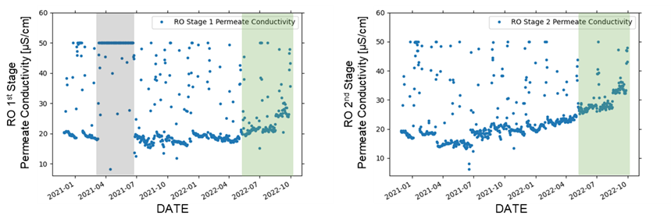
Conductivity
2. LVMWD Data RO Analysis ③Result
Supply side
These trends suggest the possibility that RO membrane clogging is progressing.
Constant conductivity
= no change in water quality
Flat
Increased conductivity
＝ Deterioration of water quality （ Green area：after June in 2022）
Permeate side
Notes:
Third is Conductivity.
This trend in orange area is data of supply side that is RO 1st Feed Conductivity.
These trends in blue area are data of permeate side that are RO 1st Stage Permeate Conductivity, RO 2nd Stage Permeate Conductivity and RO 3rd Stage Permeate Conductivity.
RO 1st Feed Conductivity have remained flat.
Constant conductivity means that the water quality is not change.
On the other hand, trends in blue area that are 1st Stage Permeate Conductivity, RO 2nd Stage Permeate Conductivity and RO 3rd Stage Permeate Conductivity increase after June in 2022 that displayed by green area.
Increasing conductivity means water quality is deterioration.
According to these treads, there is the possibility that RO membrane is clogged.

Slide 13
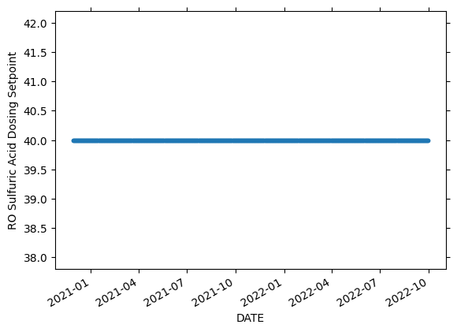
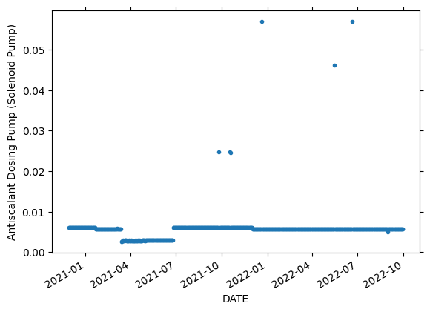
Sulfuric Acid and Anti-scalant
2. LVMWD Data RO Analysis ③Result
Sulfuric Acid and Anti-Scalant are constant values.
RO Sulfuric Acid Dosing Setpoint
Anti-scalant Dosing Pump
Notes:
Next is about Sulfuric Acid(アセッド) and Anti-scalant.
In the site, they use two types of chemical dosage, one is Sulfuric Acid and the other is Anti-scalant.
Left side is RO Sulfuric Acid Dosing trend.
Right side is Anti-scalant Dosing trend.
Both have remained flat.

Slide 14
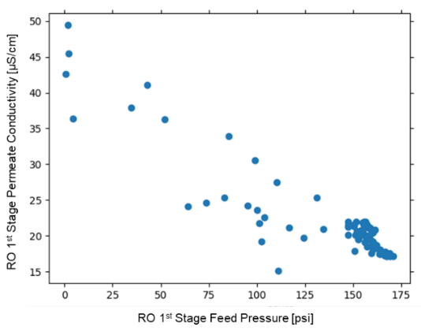
RO 1st Stage Feed Pressure and RO 1st Stage Permeate Conductivity
2. LVMWD Data RO Analysis ③Result
The correlation between RO 1st Stage Feed Pressure and RO 1st Stage Permeate Conductivity is negative. (April to July in 2022) → It matches the theoretical behavior of RO membrane.
Notes:
Next is about the correlation.
We check the correlation between RO 1st Stage Feed Pressure and RO 1st Stage Permeate Conductivity. We use the data from April to July in 2022.
This figure show that the correlation is negative.
It matches the theoretical behavior of RO membrane.

Slide 15
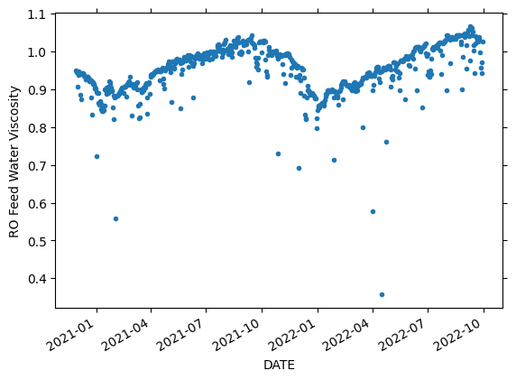
Future Tasks
2. LVMWD Data RO Analysis
Analysis of other data and construction of water quality predicting and optimization models.
Viscosity of water at temperature
Adding water viscosity variables
Water quality prediction / optimization modeling
Pre-RO
Water quality and flow rate
Prediction
Post-RO
Water quality and flow rate
Time
Time
Chemical dosage
Optimization
Re-examine the way of analysis
because of constant chemical dosage
Predict water quality and flow rate and decide values
the salt rejection
Focusing the salt rejection for driving pressure
at each stages from 1st to 3rd
Notes:
Finally, I would like to talk about future tasks.
We will analyze other data and construct water quality prediction and optimization models.
The three points are under consideration, ①viscosity of water at temperature ②Chemical dosage ③the salt rejection.
We share the concrete image of water quality prediction and optimization modeling.
Please look at the right side of the slide.
First, prediction model.
We predict the Post-RO Water quality and flow rate from Pre data of that.
Second, optimization modeling.
We decide values of control (like how much chemical, we add, how to change the pressure) under the stander of Post-RO Water quality and flow rate (for example, adapting to law regulation).
That’s all. Thank you for listening.

Slide 16
Question (SGDC to INV)
3. Q&A / Discussion

Slide 18









Analysis stance
Supplementary: RO Analytical Policy
In anticipation of the development of optimization, consider which data groups should be emphasized.
Modeling with operational optimization in mind
Formulation for operation planning optimization
Constraints and costs that need to be considered in operation are defined as formulas.
Expressing the input-output relationship of equipment as a characteristic formula
Calculate the lowest cost operation plan within constraint conditions
$$y[t]$$
Disturbance
$$L≤ "Quality" ≤U$$
: Comply with the water quality.
Identify disturbances
$$Cost = f (operation amount)$$
: Reduce operating costs
Expressing the input-output relationship of equipment as a characteristic formula
Time t
$$x[t]$$
Cost
Reduce operating costs
: Each parameters should comply with the characteristic
$$z=g(x,y)$$
Input/Manipulated
parameter
Output quality
Time t
System
$$z[t]$$
Quality
Data-driven highlighted
$$z[t]$$
Comply with demand and quality required
$$x[t]$$
Disturbance
$$y[t]$$
Time t

Slide 19
Difference per Objective
Supplementary: RO Analytical Policy
Step up from (small, easy) to (large, difficult).
(1) 最終水質と供給量を考慮
(2) RO膜閉塞状態も考慮
(3) RO膜劣化も考慮
(1) Consider water quality and flow rate in Post-RO
(2) Consider RO Clogging
(3) Consider RO Deterioration
Optimization effect
Small
Middle
Large
Short-term
(minutes to hours)
Mid-term
(days to months)
Long-term
(months to years)
Optimization period
Model strategy
Statistical/ Physical Models
Closer to statistical models
Closer to the physical model
Difficulty
Easy
Middle
Difficult
Notes:
This slide shows the procedure of RO analysis. We plan to step up from small and easy to large and difficult. There are two reasons. First reason is time-span and period in optimization. Second reason is model strategy.

Slide 20
Data List
Supplementary: LVMWD Data RO Analysis
 | variable | Measurement |  | variable | Measurement | 種類 | variable | Measurement
Pressure | 1st Feed | actual | Flow rate | 1st Feed | Cal | Conductivity | 1st Feed | actual
 | 1st Permeate | actual |  | 1st Permeate | actual |  | 1st Permeate | actual
 | 2nd Feed | actual |  | 2nd Feed | Cal |  | 2nd Permeate | actual
 | 2nd Permeate | actual |  | 2nd Permeate | actual |  | 3rd Permeate | actual
 | 2nd Concentrate | actual |  | 2nd Concentrate | actual | TOC | 1st Feed | actual
 | 3rd Feed | actual |  | 3rd Feed | Cal |  | Combined Permeate | actual
 | 3rd Permeate | actual |  | 3rd Permeate | actual
 | 3rd Concentrate | actual |  | 3rd Concentrate | actual
DP | 1st DP | Cal
 | 2nd DP | Cal
 | 3rd DP | Cal

Slide 21
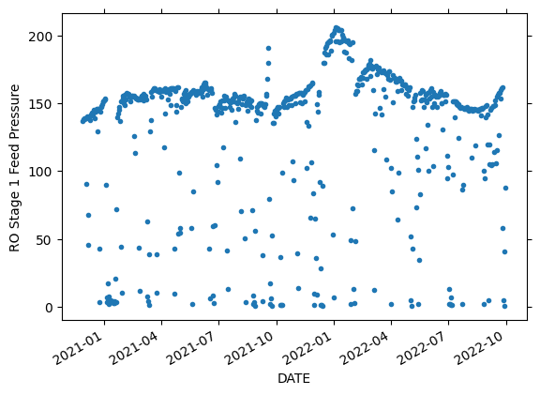
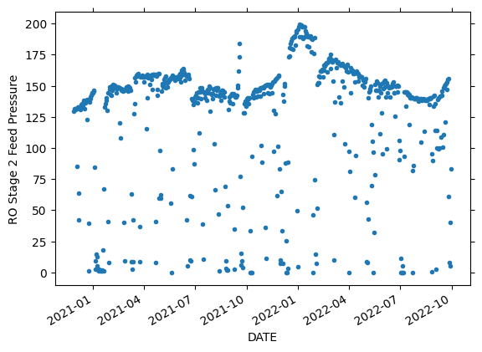
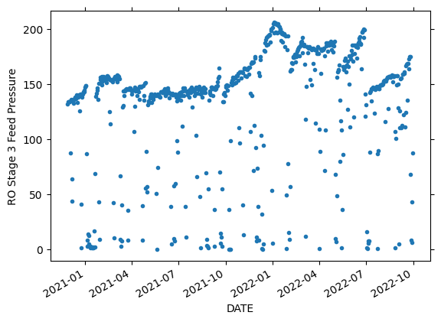
Supplementary: LVMWD Data RO Analysis
Pressure Trend (Feed)
[psi]
[psi]
[psi]

Slide 22
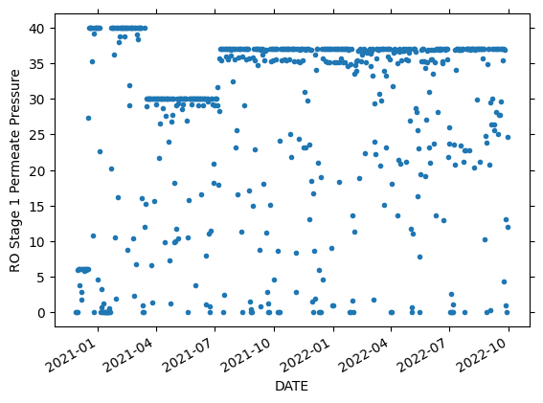
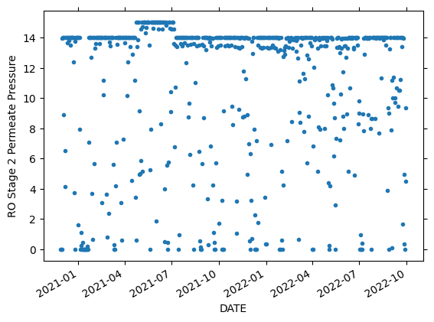
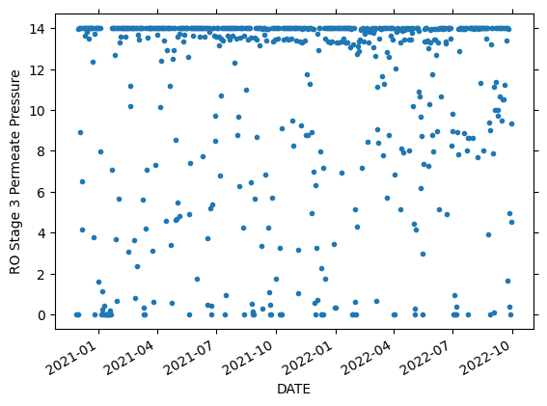
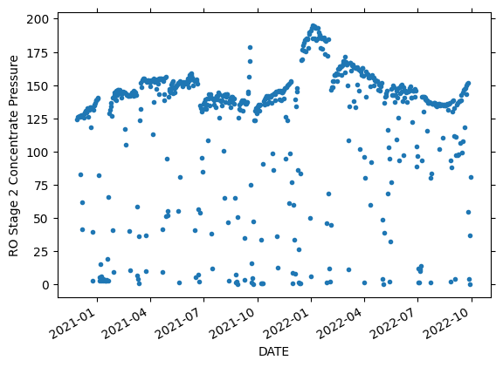
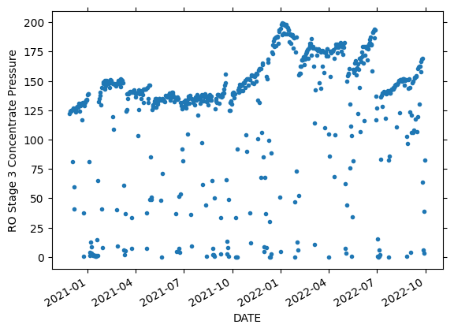
Supplementary: LVMWD Data RO Analysis
Pressure Trend (Permeate, 2nd and 3rd Stage Concentrate)
[psi]
[psi]
[psi]
[psi]
[psi]
22

Slide 23
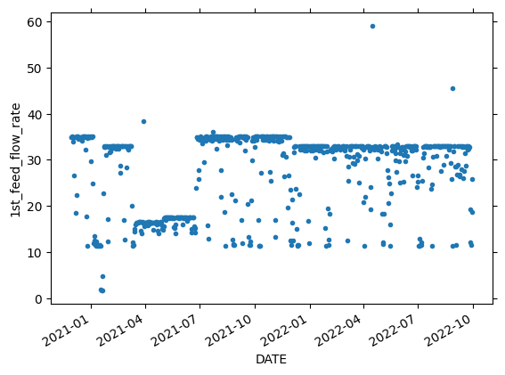
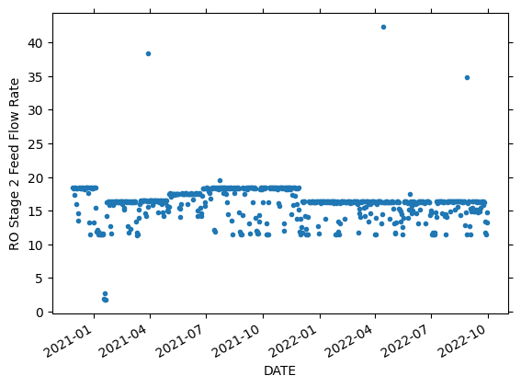
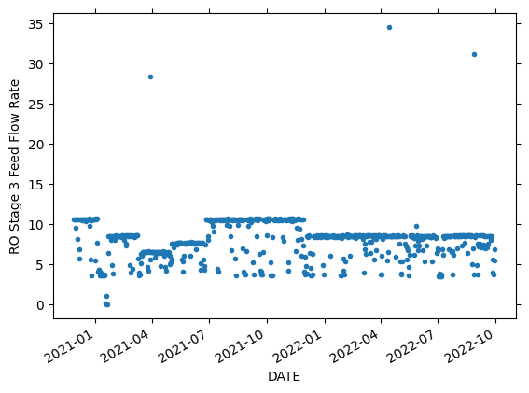
Supplementary: LVMWD Data RO Analysis
Flow Rate Trend (Feed)
RO Stage Feed Flow Rate [gpm]
[gpm]
[gpm]
1
23

Slide 24
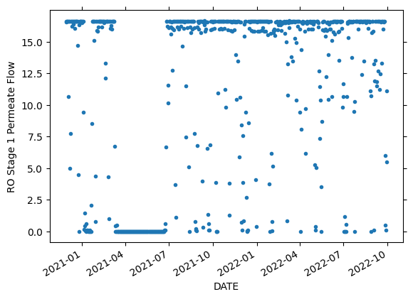
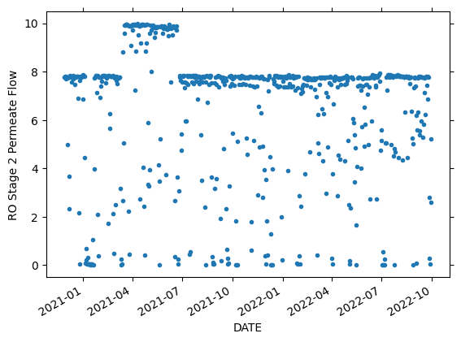
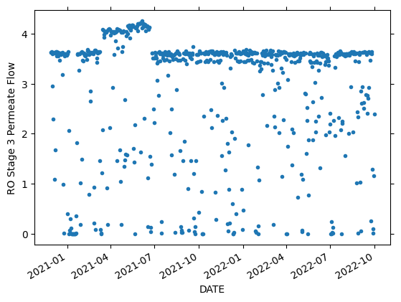
Supplementary: LVMWD Data RO Analysis
Flow Rate Trend (Permeate)
RO Stage Permeate Flow Rate [gpm]
RO Stage Permeate Flow Rate [gpm]
RO Stage Permeate Flow Rate [gpm]
1
2
3
24

Slide 25
今後の課題
2. LVMWD RO Analysis
他データの分析と、水質予測モデルや最適化モデルの構築。
流量の温度補正
水質予測／最適化モデルの構築
流量が一定の図
温度補正された流量イメージ
予測
膜前のデータ
膜後の水質
薬液添加量
時間
時間
最適化
塩分除去率
水質基準などを守る範囲で、
薬液添加量や圧力操作を決定

